Slide 1
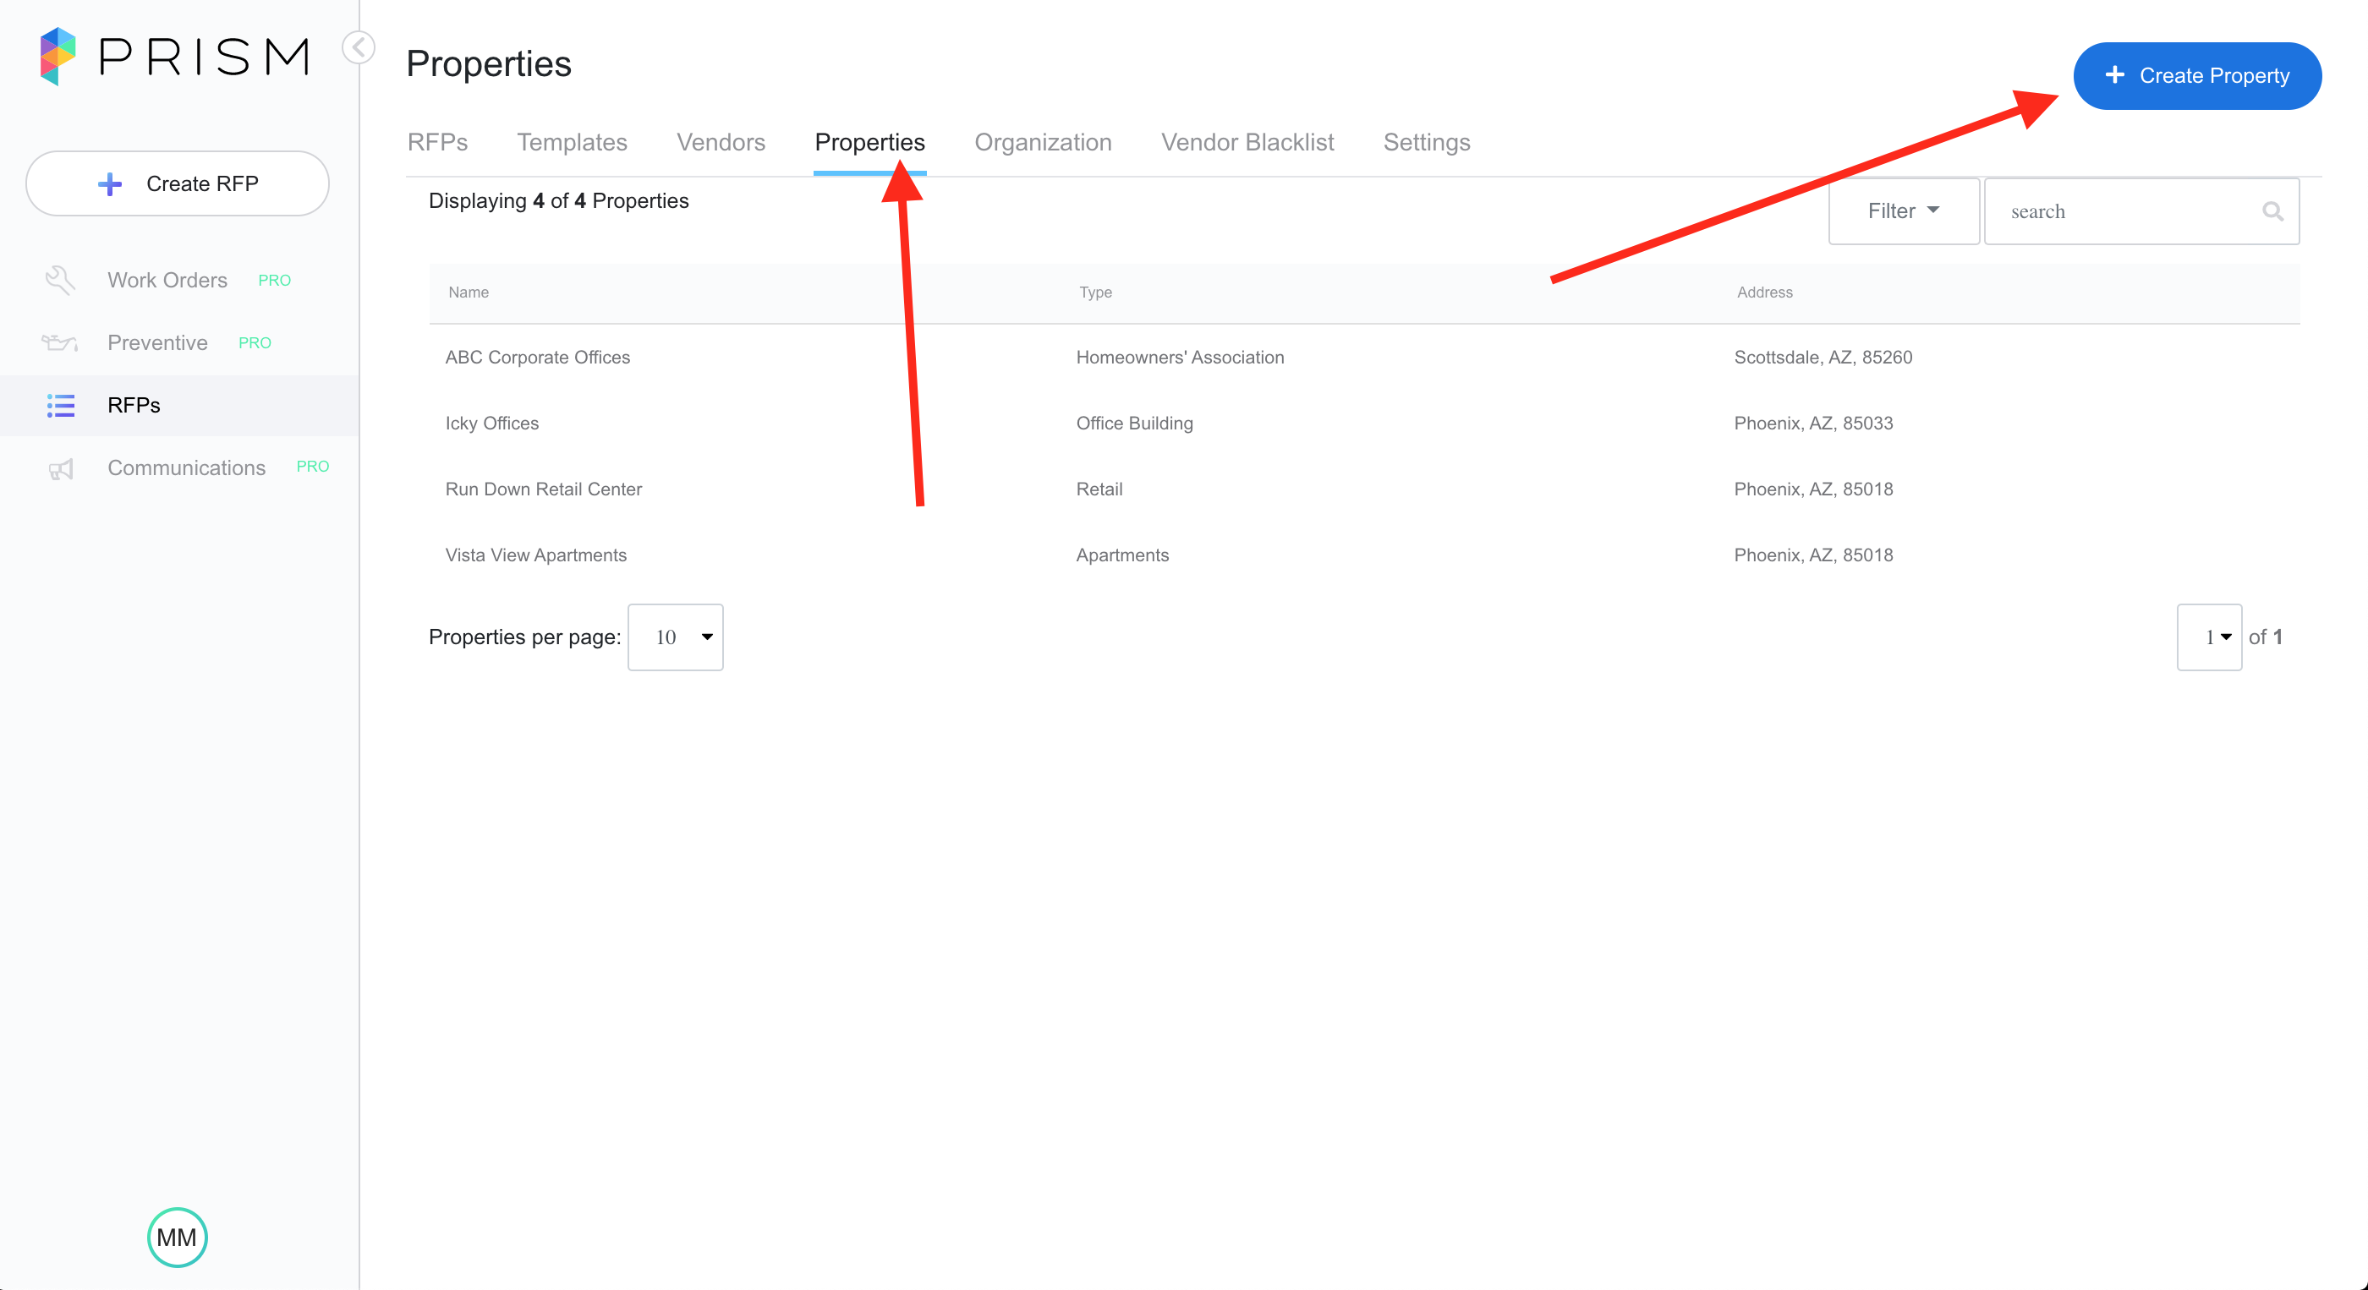
Click Properties
On the top click Properties.
In the upper right click Create Properties.

Slide 2
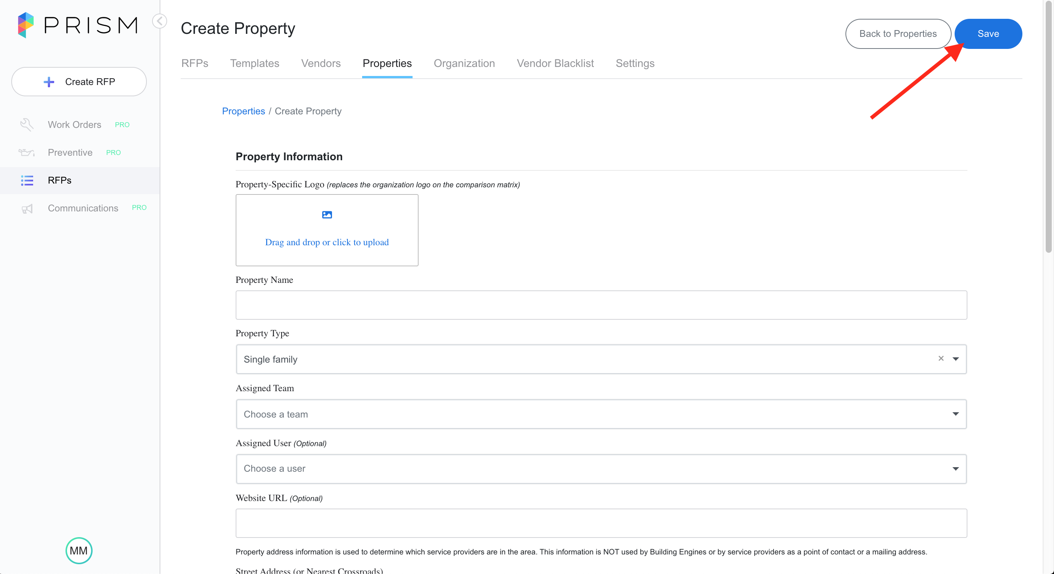
Fill in Information and Save
After Clicking Create Property you just need to fill in all the information
Make sure to click Save.
You have now added a new property!

